Slide 1
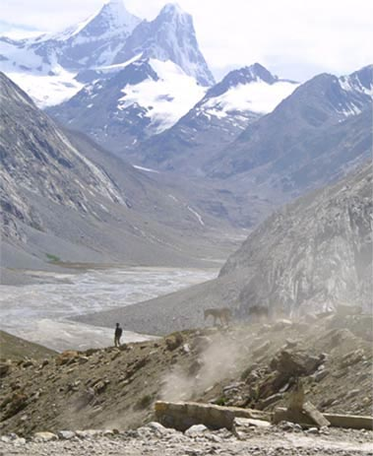
Fellowship of the Heart
Getting Started — the Four Connects, walked around the table on alternating evenings
Evening Series 2026–27 · at the Tittle home · v1.5E DRAFT
All Scripture: ESV · The Companion lesson plans carry the full scripts — these slides carry the room
1
Notes:
DECK TITLE · pre-session · DIVIDER
On screen as the room assembles on night one. All Scripture ESV; the plans carry the scripts; these slides carry the room — and these notes carry you.

Slide 2

SESSION 13
What Was Prepared for You
Connecting with Mission — uphill, downhill, and the works prepared beforehand
Quarter 3: Mission & Rhythm
164
Notes:
S13 · pre-session · DIVIDER
On screen through dinner and as the circle forms. Greet at the door — the slide holds the room.

Slide 3
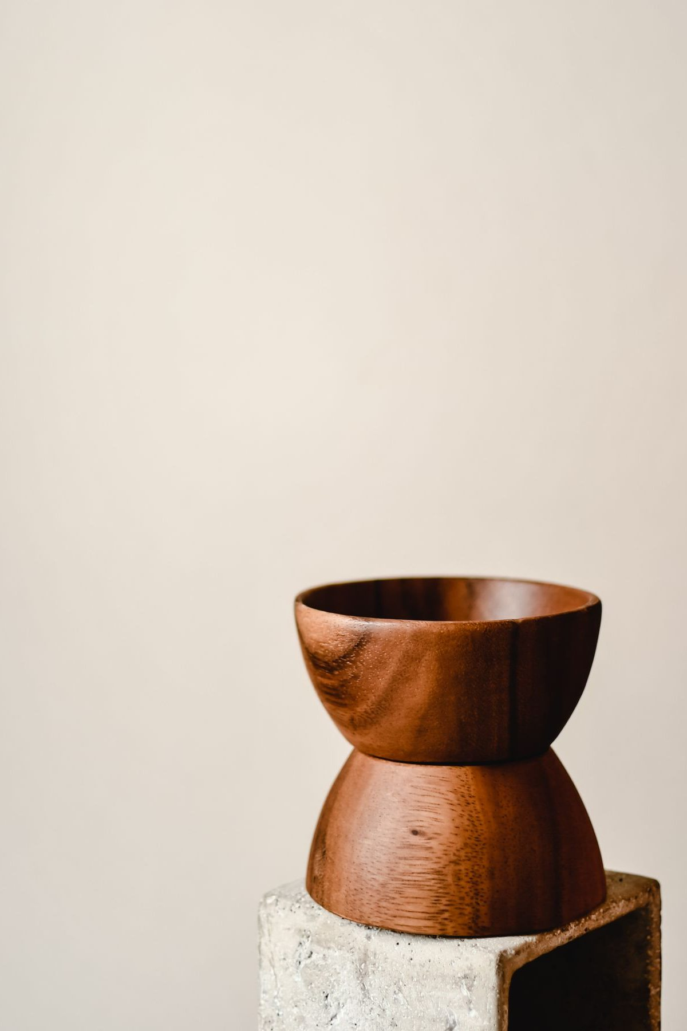
Session 13 — Tonight’s Road
1 Welcome and centering
2 Week 11 check-in
3 Ephesians 2:10 and the uphill/downhill distinction
4 Bridge to split
5 Gifts and Downhill in pairs
6 Merge and surface
7 Between-session practice and closing-weeks logistics
8 Leader Feedback Round
9 Closing container
165
Notes:
S13 · 7:00–7:08 · LEAD: CONTAINER HOLDER CIRCLE
BEATS: 1. Aaronic blessing first. 2. Container reminder: what is said here stays here; nothing is required. 3. Frame the turn: eleven weeks looked inward and upward — today we turn outward to Mission: what was prepared for us to do, and to be. 4. Walk today's road briefly: teaching, two pair exercises, merge, practice, blessing.
GUARD: Mission is bigger than career — say it early; today is not a what-will-you-do-for-a-living night.

Slide 4
Opening Container — the Eight Steps
1 Welcome — five minutes to open the container
2 Phones silenced and put away
3 Stand in a circle
4 One-word check-in — how you actually are, right now
5 Put out / bring in — set something down; bring a blessing in
6 Spoken commitment: “I am here. I am paying attention. I am willing to be moved.”
7 Opening prayer — “Holy Spirit, you are welcome here. Speak. We are listening.”
8 Sit. Begin.
166
Notes:
S13 · 7:00–7:08 · LEAD: CONTAINER HOLDER CIRCLE
BEATS: 1. Run the familiar open, unhurried: blessing; the four conditions — Safe, Present, Clear, Intentional; phones away. 2. Keep the container reminder brief today: what is said here stays here; nothing is required. 3. Settle the room before moving on — settled beats punctual.

Slide 5

Week 11 Check-In
• Before the break: Any Doubts? — and last week, The Return read what the break did with our practices
• The practice carried across: the Personal Doubts Inventory
• “Anyone want to say one sentence about how that landed — the inventory, or anything that surfaced, or that you didn’t get to it?”
• One sentence each, voluntary — received without commentary
167
Notes:
S13 · 7:08–7:25 · LEAD: CONTAINER HOLDER CIRCLE
BEATS: 1. Name the thread: Any Doubts? and the Personal Doubts Inventory carried since the break. 2. Invite one sentence on how it landed — 'I didn't get to it' counts. 3. Take two or three voluntary contributions; receive without commentary.
CUES: The arranged parent (Run Card) offers the first sentence — never a cold call on a teen; pass anytime.

Slide 6
Uphill and Downhill — Ephesians 2:10
• The works were prepared — beforehand, not by us, not for us to invent. Our job is to walk in them
• UPHILL mission — what I do: a goal, a plan, measurable steps. Good and real — and the smaller half
• DOWNHILL mission — what I am: the effect I have on the people around me when I am most aligned with the Spirit and most genuinely myself. It flows; you don’t have to push it
• The test: “When I am at my most genuinely myself — not performing, not managing, just present and open — what do the people around me get to be?”
• Eleven weeks of uphill clearing behind us — tonight we ask the downhill question
EPHESIANS 2:10
“For we are his workmanship, created in Christ Jesus for good works, which God prepared beforehand, that we should walk in them.”
168
Notes:
S13 · 7:25–7:35 · LEAD: CONTENT PRESENTER CIRCLE
BEATS: 1. Read Ephesians 2:10 slowly — the works were prepared; our job is to walk in them. 2. Whiteboard both columns: UPHILL = what I do (goal, plan, effort); DOWNHILL = what I am — what the room gets when I am most myself and most aligned with the Spirit. 3. The test: when I am not performing, what do the people around me get to be? 4. End with your OWN downhill answer — 90 seconds, specific, unpolished; the teens calibrate against your honesty. Give the version a spouse would recognize, not the resume.
GUARD: Mission is not career — reframe career drift on the spot.

Slide 7
Traveling the Mission — Tacking Against the Headwind
169
Notes:
S13 · 7:25–7:35 · LEAD: CONTENT PRESENTER
SUB: the founder's own diagram — his life drawn as a sailing chart. A substitute may teach it simply from the slide, or let it stand while running the plan's Block 3 script.
BEATS:
1. After uphill/downhill lands, show the chart: the straight line to God's goal is unsailable — headwinds, direct opposition.
2. A sailor gains against a headwind by tacking, leg by leg at forty-five degrees. Each leg IS God's direction — and each is a transformative learning path (Ephesians 2:10: works prepared beforehand, walked into leg by leg).
3. The turns are heard, not seen. Stop listening mid-leg and you don't crash — you drift past the turn, competent and off-course.
4. The threads: what leg A taught, leg C needed. Nobody sees that forward; everybody sees it looking back. Invite one backward look — name a past leg that trained you for a later one.
GUARD: testimony architecture, not a demand for a tidy life-map — some in the room are mid-leg and cannot see any pattern yet; say so.

Slide 8
Bridge to the Split — Two Exercises
1 Gifts and Passions — about twenty minutes: ten alone, ten sharing. Where are you alive? What comes naturally? Where do others tell you you have something to offer?
– Share frame: “The three things I noticed are ______. The one I’m most surprised by is ______.”
2 Downhill Mission — about twenty minutes: five alone, then name your answer to the pair. “When I am at my best, what the room gets is ___.”
– The pair adds: “What I’ve seen in you is ______.” — specific, brief, something actually seen
• In each round a parent goes first — teens choose their own depth, and passing holds
• The pair may add what they have noticed — a parent may speak to a teen’s gifts, and a teen to a parent’s
170
Notes:
S13 · 7:35–7:36 · LEAD: CONTENT PRESENTER CIRCLE
BEATS: 1. Frame the two exercises: Gifts and Passions (~20 min, H13.1), then Downhill Mission (~20 min, H13.2) — each person ends by naming one downhill sentence to the pair. 2. Pray the sending prayer. 3. Name each pair's families and its Companion; send them for forty minutes.
CUES: A parent opens each sharing round — arranged this week (Run Card), never a cold call on a teen; teens choose their own depth; pass holds. About ten or fewer today? Skip the split — one circle.

Slide 9
Gifts and Downhill in pairs
• Phase 1 — Gifts and Passions: quiet writing (10 min), then 60 seconds each: “The three things I noticed are ___. The one I’m most surprised by is ___.”
• After each share the pair affirms what it has seen — specific and brief: “Yes — we see that in you. Specifically: ___.”
• Phase 2 — Downhill Mission: five quiet minutes, then around the circle, 90 seconds each
– “What I noticed is that when I’m at my best, what the room gets is ___.”
• One or two voices add what they have actually seen across Getting Started — especially each other’s family
• The naming is the gift — no over-processing. Pass-anytime holds
171
Notes:
S13 · 7:36–8:18 · LEAD: CONTENT PRESENTER · FAMILY PAIRS
BEATS: 1. Phase 1 — Gifts (~20): ten quiet minutes on H13.1, then 60-second shares; the pair affirms briefly and specifically. 2. Phase 2 — Downhill (~20): five minutes on H13.2, then 90-second rounds: the person names their answer, the pair adds what it has actually seen; family speaking to family lands deepest. 3. If time compresses, compress the gifts, never the downhill.
CUES: The arranged parent goes first in each round (Run Card); never cold-call a teen; pass anytime.
GUARD: Push generic to specific — what does the person you're helping get to be? Witness means concrete moments, not flattery. If grief surfaces ('I haven't been doing this for years'), receive without rushing — it is part of the recognition.

Slide 10
Merge and Surface
• What was named in your pair stays in your pair — nobody repeats their downhill answer
• One sentence from each leadsanion — one general thing they noticed, not a specific person
• Then one observation across the room
• “The downhill mission you named is not a final answer. It is the working draft you are walking in this season.” It will deepen. It will sharpen
172
Notes:
S13 · 8:18–8:20 · LEAD: CONTENT PRESENTER CIRCLE
BEATS: 1. Ask no one to repeat their downhill answer — what was named in the pair stays there. 2. One sentence per leadsanion: a general observation, no names. 3. One brief observation from you across the room. 4. Land it: today's answer is a working draft — closer to true than the resume version, and it will deepen.
GUARD: Five minutes only — this block gave its other five to the feedback round; a sentence each.

Slide 11

Practice This Week — and the Road Ahead
• One small action this week, aligned with your downhill answer. One. Not a campaign. Specific — then journal what happens
– If your downhill is “the room gets calmer” — sit with a friend in distress this week instead of trying to fix them
• Ahead: the Rhythm week — we build the practices you will carry when the Wednesdays stop
• Week 21 — the family commissioning: bring your whole family, even members who have not been here. We run to 6:15 that night — light food from 4:00 as the room builds
• Week 22 — the commissioning of our Companions-in-Formation. Their night; come to witness it
173
Notes:
S13 · 8:20–8:24 · LEAD: CONTENT PRESENTER CIRCLE (Parent Co-Companion leads if present)
BEATS: 1. The practice: ONE small action this week aligned with your downhill answer — specific, small, not a campaign; journal what happens (H13.3). 2. The road ahead: Week 15 is the Rhythm night and finishes today's mission work; Week 21 is the family commissioning — bring the whole family, 6:30 start, light food at 6:00, details by email; Week 22 commissions the Companions-in-Formation — come to witness.
GUARD: Be explicit and warm about Week 21 — people leave today deciding who to bring. Adjust specifics to the actual closing-weeks plan.

Slide 12
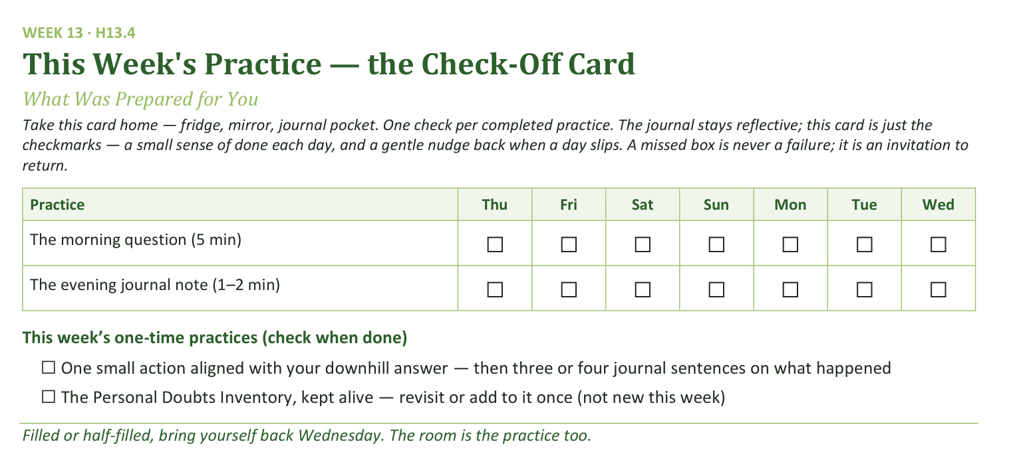
Your Take-Home Card — This Session’s Practice
Handed out now — fridge, mirror, journal pocket.
174
Notes:
S13 · 8:20–8:24 · LEAD: CONTENT PRESENTER CIRCLE
BEATS: 1. Point to the check-off card: the morning question and the session journal note, daily, carried forward. 2. One-time boxes: the one small downhill action, and the Doubts Inventory kept alive. 3. Say the card's spirit: a missed box is never failure — it is an invitation to return; filled or half-filled, come back evenings.

Slide 13
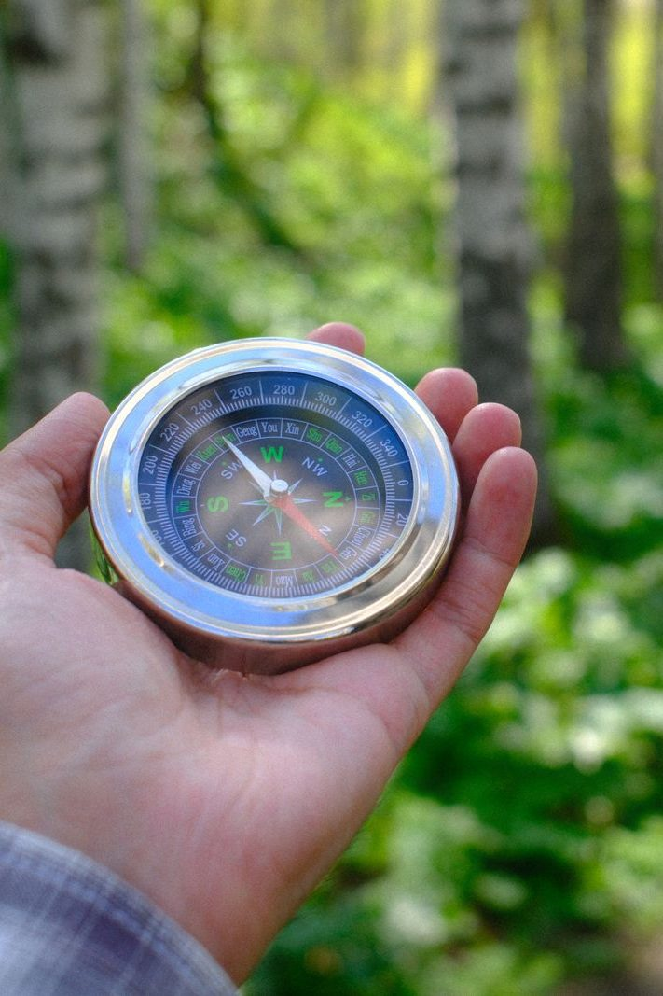
The Leader Feedback Round
• Two rounds, same as every session — the container holder first, then the content presenter: three things each
– “What I think went well tonight: ______”
– “What I’d do differently next time: ______”
– “If I were to teach tonight’s process to someone, I would tell them: ______”
• Then the room — the same two questions about tonight
• The leaders receive without defending — “thank you” is the whole response
175
Notes:
S13 · 8:24–8:28 · LEAD: BOTH LEADERS CIRCLE
BEATS: 1. The leader's three, same as every week: what went well; what I'd do differently; what I'd tell someone teaching today's process. 2. Then the room, same two questions — two or three voices each is plenty. 3. Receive without defending — 'thank you' is the whole response.
CUES: If a teen led today, they answer first, the adult second; the room's feedback covers both. The round may be dropped if the room needs something else — dropping it twice running goes to the team debrief.

Slide 14
Closing the Container + Aaronic Blessing
• We close the way we opened — the container, six steps:
1 Stand again — same circle, same posture as the open
2 One-word landing — compare it to your opening word
3 The one thing you are taking from tonight
4 The one practice — committed aloud, or modified to one you will actually keep
5 Blessings — specific, witnessed, short
6 Closing prayer — and the Aaronic blessing, spoken over each other, face to face
THE AARONIC BLESSING — NUMBERS 6:24–26
“The Lord bless you and keep you;
the Lord make his face to shine upon you, and be gracious to you;
the Lord lift up his countenance upon you, and give you peace.”
176
Notes:
S13 · 8:28–8:30 · LEAD: CONTAINER HOLDER CIRCLE
BEATS: 1. What was named in your pair is yours — carry it gently; the downhill answer keeps deepening across the week. 2. Open the door for the heavy: shadow-mission recognition or mid-life vocational grief — reach out; the team is walking with you, especially before when we gather. 3. Aaronic blessing, hands up if you want; send them warmly.

